Slide 1
6.2 Water and Diffusion

Slide 2
Diffusion
Movement of particles from an area of higher concentration to an area of lower concentration.
Brownian motion
- random motion of atoms/molecules
Examples: food coloring in water, perfume, tea

Slide 3
Rate of diffusion
What can speed up diffusion?
  Concentration- more particles (#1 factor)
  Temperature- particles move faster
  Pressure- accelerates particles

Slide 4
Importance of Diffusion
Oxygen
Nutrients
Waste
enter and exit cells by diffusion

Slide 5
7.2 Plasma Membrane
Semipermeable, flexible boundary between the cell and its environment
Cell Functions:
  - Need food - Need O2 ; Give off CO2
  - Use energy - Send messages
  - Give off waste - Maintain homeostasis
  * All must pass through a membrane

Slide 6
Selective Permeability
Membrane allows some molecules to pass through; keeping others out
  Water, Oxygen, CO2, Nitrogen move freely
  Sugars, amino acids, and fats cannot pass freely

Slide 7
Structure: Phospholipid Bilayer
Two layers:
  Each composed of lipids
  Protein molecules embedded in layer
Phosphate group instead of 3rd fatty acid
  Attracts water

Slide 8
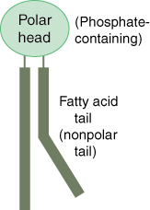
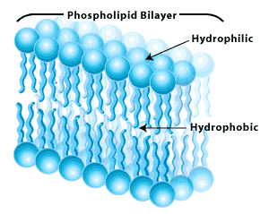
Structure: Phospholipid Bilayer
Phospholipid contains:
  polar head → attracts water
  non-polar tails → repels water

Slide 9
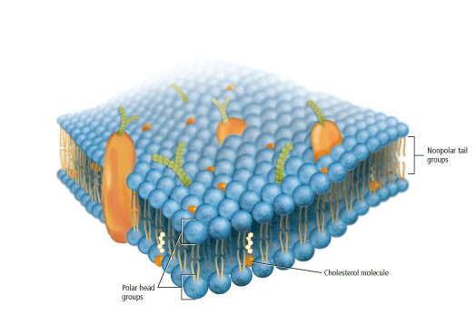
Fluid Mosaic Model
Phospholipids are free to move sideways
  Like ping-pong balls in a bucket of water

Slide 10
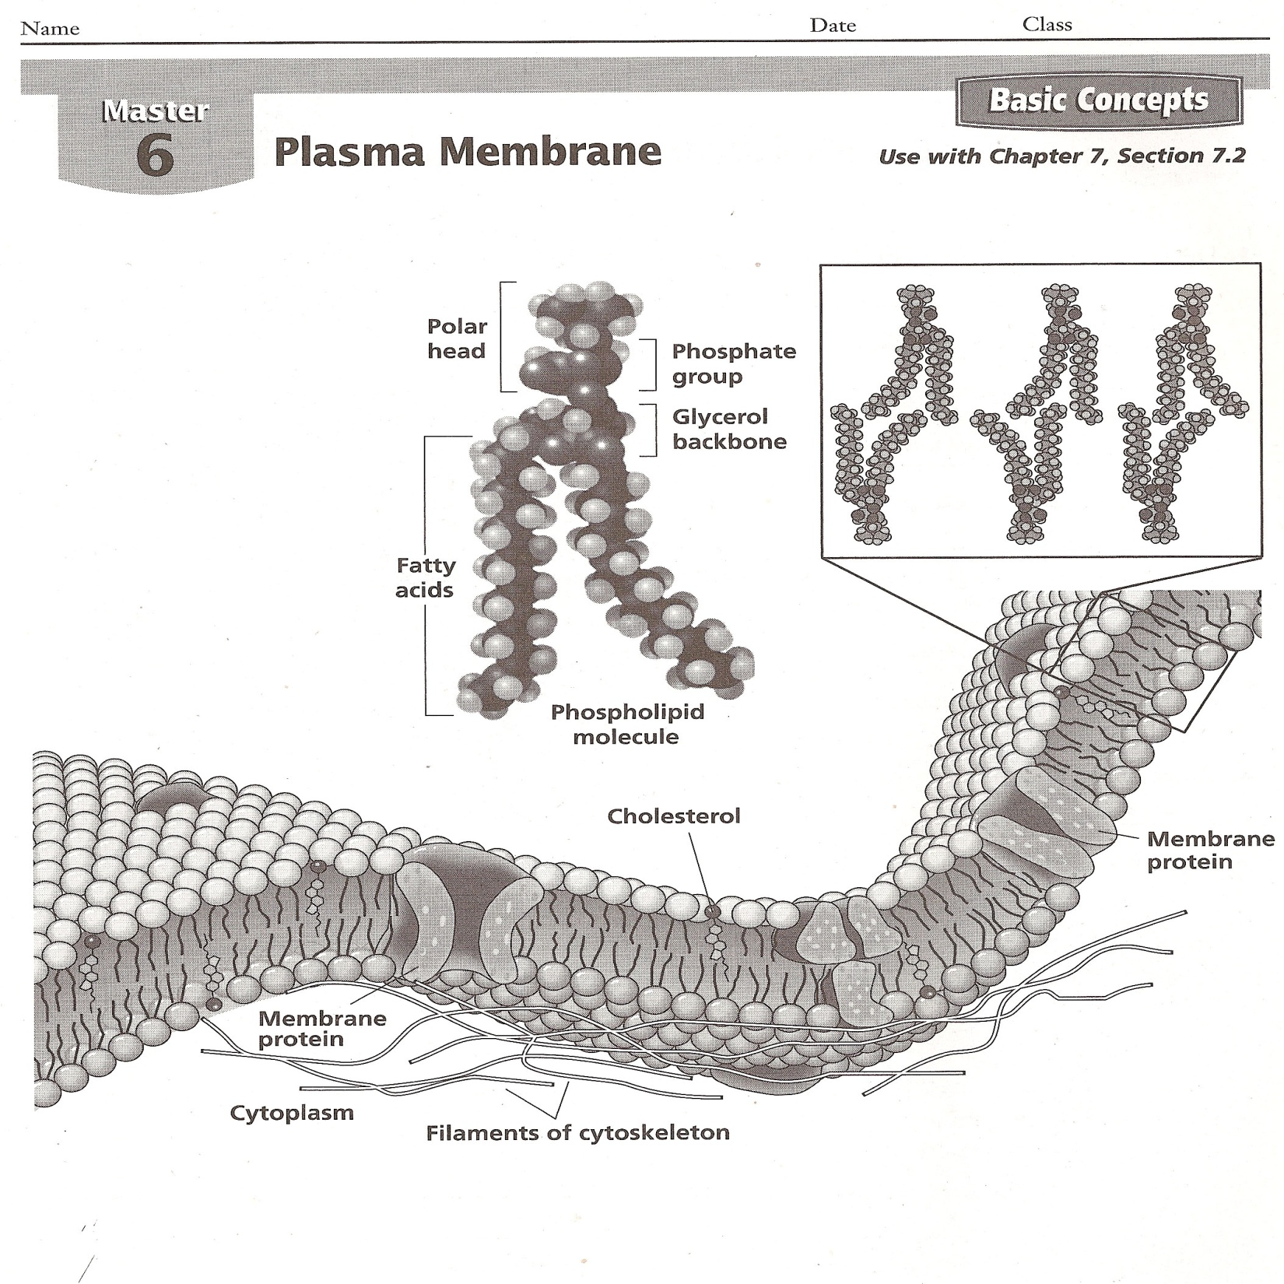

Slide 11
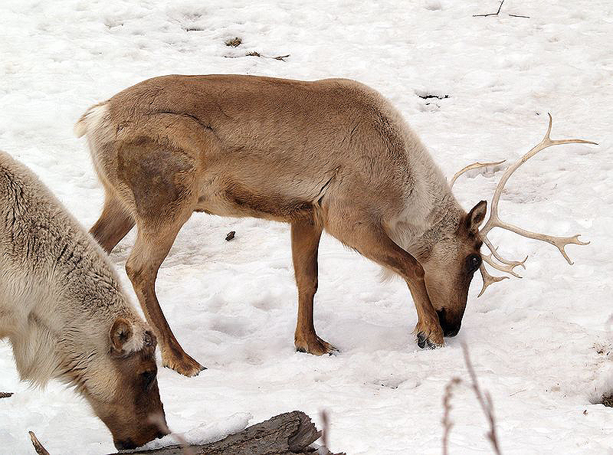
Saturated vs. Unsaturated Fatty Acids
The more unsaturated fatty acids, the more fluid the membrane.
Caribou example

Slide 12
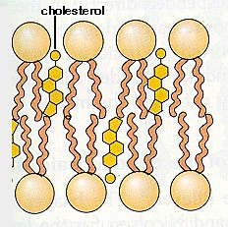
Cholesterol
Strengthens the fluid mosaic
Keeps tails separated

Slide 13
Membrane/Transport Proteins
May extend through one or both layers
Determine which particles can pass
Markers- recognize chemicals/fight disease

Slide 14
8.1 Cellular Transport
Osmosis
  diffusion of water across a membrane
  helps to maintain homeostasis
  Why should I avoid drinking sea water?
  Isn’t some water better than no water?

Slide 15
Saltwater
The saltwater is 4 times more salty than your blood. The water from your blood passes into your stomach to dilute the salt concentration causing diarrhea. The water from your body cells pass into the blood to dilute the rising salt concentration causing hallucinations, seizures, and heart problems.

Slide 16
Which way will the water cross?
Since the particles cannot cross, the water will cross
High to low concentration
Right to Left ← dilutes solute concentration

Slide 17
Types of Solutions
Isotonic - equal concentrations
Hypotonic - solute conc. is lower outside
Hypertonic - solute conc. is higher outside

Slide 18
Isotonic Solution
Concentration of dissolved substance (solute) is the same inside as it is outside of the cell
Dynamic equilibrium- no net movement of water
“changing” “same”

Slide 19
Hypotonic Solution
Concentration of solute is lower outside the cell as it is inside the cell
Water moves into the cell
Turgor pressure- pressure inside a cell
  Increases in a hypotonic solution
Ex: Grocery store, House plants

Slide 20
Hypertonic Solution
Concentration of solute in higher outside the cell than inside the cell
Water moves out of the cell
Animal cells shrivel or crenate
  Do not salt meat before cooking!

Slide 21
Passive vs. Active Transport
Passive does not require energy
Active requires energy

Slide 22
Passive Transport
Movement of particles across a membrane by diffusion.
No energy required
Facilitated diffusion- enter by transport protein
  Ex: sugar and amino acids

Slide 23
Active Transport
Movement of materials against a concentration gradient requiring energy (low→high)
How active transport occurs:
  Particle binds with protein
  Uses energy to change the shape of the protein
  Particle is released to the other side

Slide 24
Transport of large particles
Endocytosis-
  cell surrounds material
  Forms a vacuole using the plasma membrane
Exocytosis-
  Reverse process for expelling wastes
  Both use energy to move masses of material

Slide 25
Fish: Saltwater vs. Freshwater

Slide 26
8.1 Section Review 1-5 p.200

